Slide 1


LECTURE
Player Motivations
Game Production
Diploma in IT
Notes:
Hi ho everyone! In this lesson, we will be talking about player motivations. Why do people play games? The obvious answer is to have fun, but what is fun? Also, what’s fun for one person might not be fun for another, so can we group gamers into categories to help us design games for specific types of gamers? That’s what we will be discussing today.

Slide 2

Before We Continue…
Take the 5-minute survey at Quantic Foundry to get your Gamer Motivation Profile
https://quanticfoundry.com/
Notes:
Before we continue any further, I want all of you to take this 5-minute survey from the Quantic Foundry website to get what they call your Gamer Motivation Profile. The link to the survey is at the top right hand corner when you go to their landing page.
I’m serious. Do not continue this lesson before you do this survey. Hit that escape button right now to get out of this slide show and go do the survey. Then come back. I’ll wait.
You’re done? OK, let’s continue.

Slide 3
Why Do We Play Games?
Games are not important!
Why do (some) people play games instead of
Earning money?
Exercising?
Going out with friends?
Learning a skill?
Creating a work of art?
Attending classes? Listening to a lecture? Doing assignments? Studying?
Notes:
Have you ever thought about why people play games? Because strictly speaking, games are not important, and there are lots of other things that are objectively more worthwhile that people can do.
Why do people play games instead of earning money? After all, we all need money to survive. We could improve our health by exercising. Or we could satisfy our need for social interaction by going out with friends (or at least, we could when there isn’t a deadly virus ravaging the world). We could instead learn a skill like sewing or playing a musical instrument. We could paint or sculpt or create a work of art.
Why do people play games instead of attending classes? Listening to a lecture? Doing assignments? Studying? You know who you are.

Slide 4
Maslow’s Hierarchy of Needs
Self-
Actualization
Pursue Inner Talent, Creativity, Fulfillment
Self-Esteem
Achievement, Mastery, Recognition, Respect
Love / Belonging
Friends, Family, Lover, Spouse
Safety
Security, Stability, Freedom from Fear
Physiological
Food, Water, Shelter, Warmth
Notes:
To help put some perspective on why people play games, we refer to the work of American psychologist Abraham Maslow who published the paper “A Theory of Human Motivation” in 1943. In that paper, he proposed that all people have a hierarchy of needs, which he depicted using a pyramid. His theory is that all people have these needs, but the lower level needs must first be met before the higher level needs can be addressed (although there is some overlap). He divided the needs into 5 levels.
The first and most basic level is Physiological, which is all the physical needs that a person must meet in order to survive, including food, water, shelter and warmth. Clearly, a person’s first priority is not to die of starvation, thirst or exposure to the elements.
Assuming the basic physiological needs are met, the next level is Safety. This includes physical safety (so, protection from wars, natural disasters or, hmm, what’s another good example, coronavirus); stability in the form of job security or political stability; and freedom from fear and abuse both physical and emotional.
Once your physiological and safety needs are met, the person is in no immediate danger of perishing. They have a home, a source of income to provide food and water, and a reasonable assurance that this will continue. They can now move on to the next level, which concerns Love and Belonging. This includes their relationships with family and friends, and eventually finding a life partner and spouse. This is also the level where people start to play games, because people in a warzone is unlikely to be playing Pokemon Go while hiding from enemy soldiers.
Assuming you have your social needs fulfilled, with a group of friends to provide a support structure and even a significant other, then in the next level you can focus on your Self-Esteem. This is done by accomplishing achievements and acquiring mastery of skills, which gains you recognition and respect. In fact, there are two versions of self-esteem needs. The "lower" version is the need for respect from others. This may include a need for status, recognition, fame, or attention. The "higher" version is self-respect. Such as a desire for competence, mastery, independence, and self-confidence.
Finally, on top of the hierarchy is the need for Self-Actualization, which is the desire to realize one’s full potential. Once a person feels safe, loved and accomplished they can now focus on pursuing inner talent, being creative, pushing the boundaries and fulfilling personal goals. This goes beyond the desire for competence, it is doing things for the sake of improving oneself, even if there is no tangible benefit.
So, why do people play games? Part of the answer lies in the fact that playing games helps to fulfill some of these needs, particular towards the top of the hierarachy. You can gain recognition from being top of a leaderboard, or a sense of achievement in solving a tough puzzle, or the social belonging of going on a group raid on a tough boss.
There is also a clue to why people find games fun here. Notice that video games often put you in situations towards the bottom of the hierarchy, from survival games like Don’t Starve to combat games like CSGO, yet you get to experience this from the comfort of your own home. In fact, there are games that simulate scenarios that every single level on Maslow’s Hierarchy of Needs. Games tap into some primal part of us without putting your life in danger, which is all part of the fun.

Slide 5
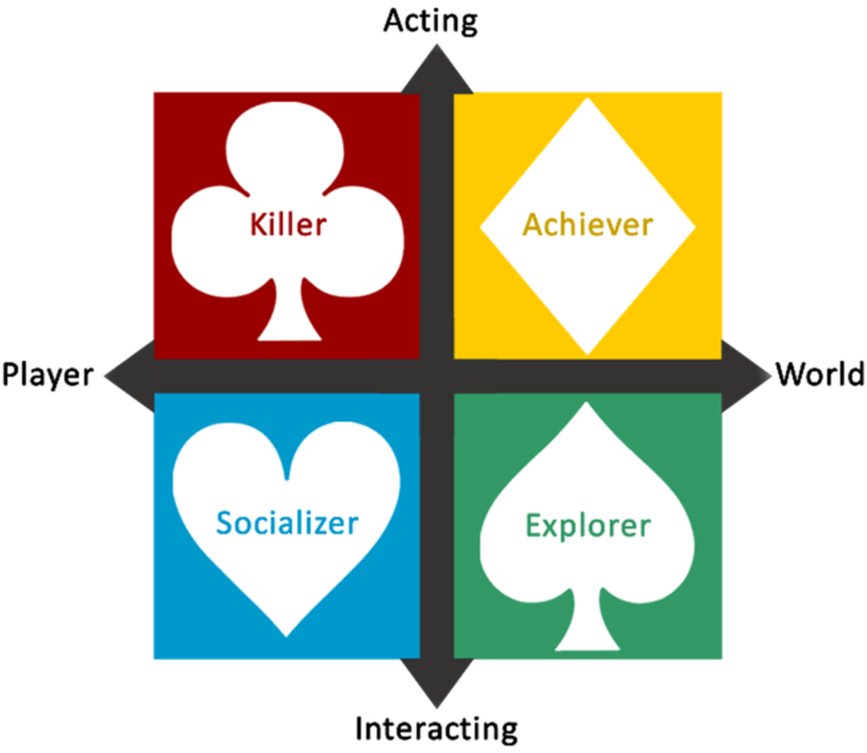
Bartle’s Taxonomy of Player Types
Notes:
Maslow’s Hierarchy of Needs is a model that was proposed in the field of sociology. For a study that is directly related to video games, we turn to Richard Bartle’s Taxonomy of Player Types that he published in his 1996 paper. While this initial research focused on the old text-based multi-user dungeons (or MUDs), Bartle’s Taxonomy is one of the more popular ways to classify player types used in the game industry today.
The taxonomy separates players into 4 quadrants depending on where they lie on two axes. On the y-axis, players closer to the Interacting side prefer to react and interact with external happenings, while players closer to the Acting side prefer to decide what to do for themselves. The x-axis measures whether the player prefers to interact with other players or with the game world.
Those that prefer to act independently and interact with the world are called Achievers. They want to achieve the goals of the game, and their primary pleasure is overcoming challenges. And yes, this includes unlocking achievements, and collecting all the Pokemon. Which is why they are denoted by Diamonds, because diamonds are cool and shiny and bling. Did I use that term correctly? I’m going to pretend I did.
Those who prefer to experiment with what the world can offer are known as Explorers. They want to get to know the breadth of the game, and their primary pleasure is discovery. They enjoy finding exploits, glitches and easter eggs, and they are also known as Spades because they like to dig around the game world.
Those who prefer to interact and respond to people are known as Socializers. They primarily seek the pleasures of fellowship and relationships. Sometimes the game is just a tool for the socializer to make and interact with friends, and they are often the target audience for casual, social games or massively multiplayer online games. They are denoted by a Heart because, you know, wuv.
Finally, the ones who want to act independently and affect other players are known as Killers. They are interested in imposing themselves on others, which includes both competing with and defeating others as well as helping others. In particular, they far prefer playing with other humans than computer AI. Obviously they are represented by a Club, because whackety whack.
So, what kind of gamer do you think you are?

Slide 6
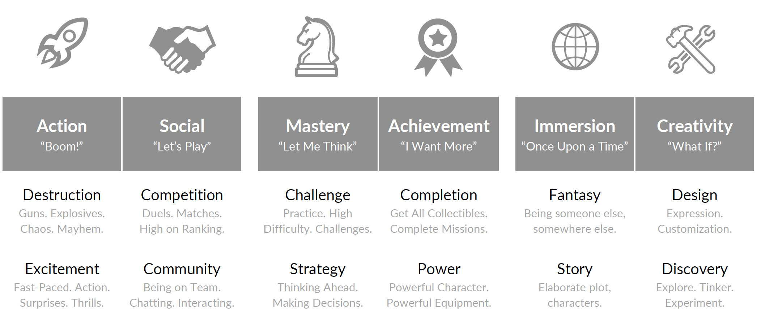
Gamer Motivation Model
Quantic Foundry GDC 2016 talk
https://quanticfoundry.com/2016/04/07/gdc-talk/
Notes:
While Bartle’s Taxonomy proposed in 1996 gives a convenient 4-way classification of gamers, others have proposed alternative classifications. In the Game Production module, the main one we will adopt is the Gamer Motivation Model proposed by Nick Yee and supported by his company Quantic Foundry – that’s the survey you all did at the start of this lesson. This model was developed using data analytics on the survey results from over 400,000 gamers.
The Gamer Motivation Model classifies game motivations into 6 categories:
Action gamers are those who enjoy excitement and destruction. They like fast-paced twitch games with lots of surprises and explosions. I suspect they also watch Michael Bay movies. You know who you are.
Social gamers like to interact with others, either by competing with them in duels or deathmatches, or by cooperating with them in a party tackling a big boss, or even just chatting with others in a forum. Yes, many researchers say that competition and cooperation are not opposites, but are instead synergistic, and this model based on survey results agree with this.
Mastery gamers enjoy overcoming challenges through developing great skill or by employing clever strategies. They love beating games at high difficulty levels and discovering cool character builds or efficient techniques when playing games.
Achievement gamers are your “gotta catch ‘em all” gamers. They want to get all the stuff, complete all the side-quests, and also to build the most overpowered and blinged-out character possible.
Immersion gamers are those who want to really get into the game world. They will read every bit of text and watch every cut-scene in order to transport themselves into a different place, and they will get invested in the relationships and happenings in the world.
Creativity gamers love to put their own mark into the game. They are the ones who will spend hours customizing their character with the right hair, skin colour and nose shape, and don’t mind making a few microtransactions for some new clothes or a pet kangaroo with no in-game effect other than looking cute. They also tend to enjoy discovering what the game can offer by exploring the map and playing around with stuff like crafting.
It turns out, the survey data showed that the 6 categories can be divided into 3 pairs that are related to each other. Action and Social gamers like a lot of the same games, as do Mastery and Achievement gamers, and also Immersion and Creativity gamers. Also, membership in these categories is not binary, so it’s not like you are either an Action gamer or not. Instead, these category pairs form spectrums, and gamers will fall somewhere on these spectrums.
For more details, you can watch the 20-minute talk by Nick Yee that he game in the 2016 Game Developer’s Conference.

Slide 7
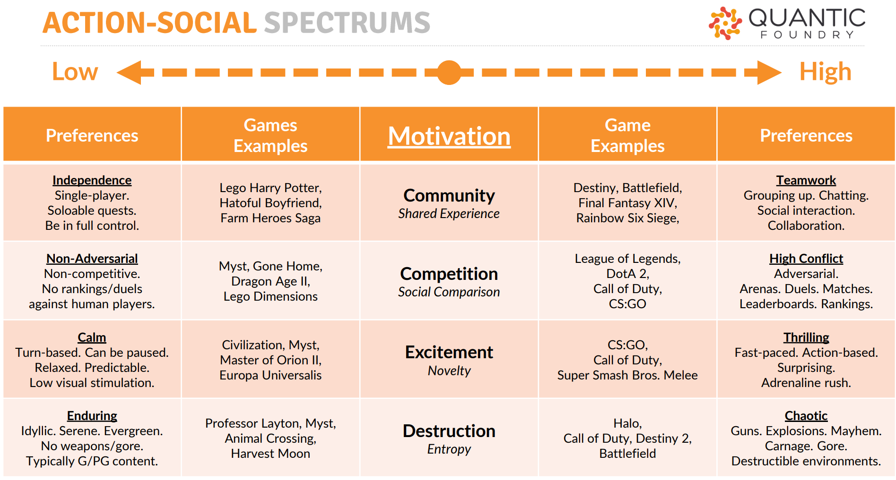
Action-Social Spectrums
Notes:
Let’s look at each of these spectrums a little more closely. For each spectrum, there are 4 different motivations. On the Action-Social spectrum, the motivations are Community, Competition, Excitement and Destruction.
Community refers to how much you like to share your experience with others. Those low on the Community scale prefer to be independent when gaming, and will favour single-player games or the ability to play solo on an MMO. They might like solo games like Lego Harry Potter, visual novels like Hatoful Boyfriend, or even social games with limited interaction like Candy Crush. Those high on the scale prefer to group up, collaborate and have lots of social interaction, so co-op games like Destiny or Rainbow Six Siege are more their jam.
Competition refers to how much you like to compare yourself to others. If you are low on the Competition scale, you would prefer to be non-adversarial and non-competitive. These “care bear” gamers may like solo adventure games or RPGs like Myst or Dragon Age. If you lare high on the Competition scale, then you’re likely to get a kick out of arenas and duels, and strive to go up the leaderboards or rankings. E-Sports like LoL, DOTA and CS:GO are the domain of competitive players.
Excitement relates to the nature of the gameplay, whether it’s calm and calculated or thrilling and instinctive. If you are low on the Excitement scale, then you enjoy games where you have time to think and plan, so turn-based games like Civilization or Europa Universalis will be suitable. Those adrenaline junkies high on the Excitement scale prefer fast-paced action-based games, like Call of Duty or Super Smash Bros.
Finally, there are those who prefer their games peaceful and serene with little conflict. These gamers will be low on the Destruction scale, preferring the idyllic gameplay of games like Animal Crossing or Harvest Moon. Others just want to see the world burn. They enjoy games like Halo or Destiny 2, with guns, explosions, carnage, gore, and the smell of napalm in the morning.

Slide 8
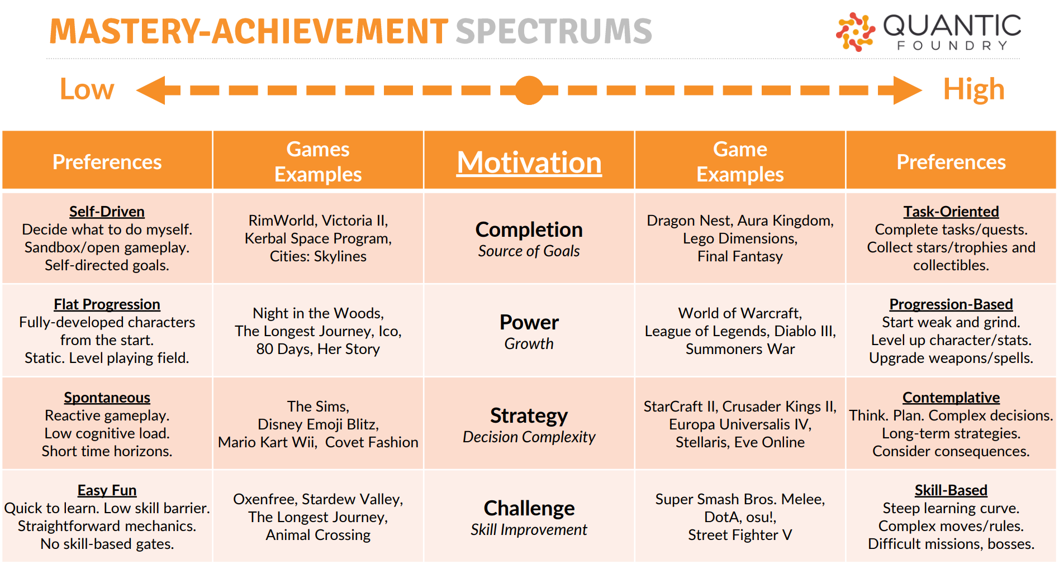
Mastery-Achievement Spectrums
Notes:
Under the Master-Achievement spectrum, the motivations are Completion, Power, Strategy and Challenge.
Completion refers to whether derive satisfaction from having the game to give you a list of things to check off. If you are low on Completion, you would prefer to decide what to do for yourself, so you would enjoy sandbox games like Kerbal Space Program or Cities: Skylines. On the other end of the scale, those high on Completion will like games with quantifiable tasks or achievements, like collecting all the cool loot in Dragon Nest or unlocking all the summons in Final Fantasy.
Another concern for Mastery-Achievement players is Power, which is whether care if your in-game abilities improve. Those who don’t care for Power gameplay would prefer a level playing field, and often head towards adventure games like The Longest Journey or Her Story. And then there are the Power gamers who like nothing more that to level up their characters and accumulate OP loot, so games that allow lots of powering up like WoW or Diablo are their drugs of choice.
Strategy refers to the gamer’s enjoyment of making long-term overarching plans. Those who don’t like Strategy gravitate towards more reactive games that don’t require too much long-range planning, like Mario Kart or The Sims. Then there are those who prefer the super involved strategic planning of games like Starcraft, Europa Universalis or Stellaris, where their complex decisions can have consequences hours later. They really love it when a plan comes together.
Finally there are those who play games for a Challenge, and those who play games primarily to relax. Those who aren’t looking for a Challenge when gaming will like straightforward games that are easy to learn, like Stardew Valley and Animal Crossing. Then there are those masochists who want to be pushed to their limits, who enjoy spending time mastering complex moves or defeating tough bosses. Games like Street Fighter or DOTA fill this category. You know those people playing osu with one hand and the sound off while eating a sandwich? Those guys.

Slide 9
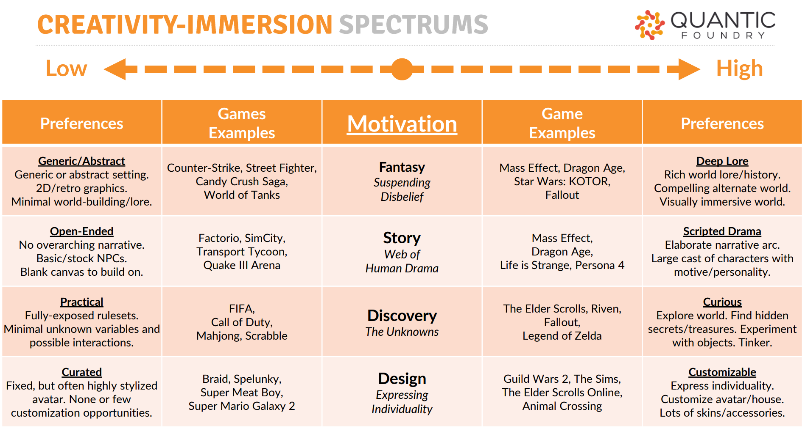
Creativity-Immersion Spectrums
Notes:
The Creativity-Immersion spectrum relates to Fantasy, Story, Discovery and Design.
The Fantasy scale measures whether the gamer enjoys a detailed and immersive game world, or do they prefer something functional that does not detract from the core gameplay. If you are low on the Fantasy scale, you would prefer games with a generic or even abstract setting, possibly 2D games with retro graphics. Examples include Candy Crush, World of Tanks and Counter-Strike, where the back story is incidental and the gameplay is front and centre. On the other hand, those who like Fantasy enjoy games with a rich world and lore, preferably with gorgeous and immersive graphics. Games like Mass Effect, Star Wars: Knights of the Old Republic or Fallout allow these players to fully immerse themselves and escape the real world while they are playing.
There are those who favour a scripted and involving Story, and those who would prefer the story to emerge from the gameplay. If you don’t really care for a scripted story, then open-ended games like Factorio or SimCity allows you to design your own world within the bounds of the game. On the other hand, those who enjoy Story in their games would gravitate towards elaborate narratives and characters with personality, like Mass Effect, Life is Strange or Persona 4. And of course The Last of Us. You have to mention The Last of Us. You’ve all played The Last of Us, right? No? Philistines.
The third motivation on the Creativity-Immersion spectrum is Discovery, which is whether you want to know everything about the game beforehand or would rather discover more as you play. Games like FIFA, COD or Scrabble have everything laid out for you up front – there are no surprises other than whether Ronaldo or Messi is the better player (it’s Messi), so gamers who don’t care for Discovery will favour these types of games. The ones who like Discovery want to explore rich worlds, find hidden secrets, and experiment with the game system. They will enjoy open-ended games like Skyrim or Legend of Zelda, the bigger the better.
Finally, we also consider whether the gamer likes to Design. Those who don’t care for Design don’t mind having the game designer do all the work, so they can just start the game and go. Games with just a single playable character like Super Mario Galaxy or Super Meat Boy are just fine with them. On the other end of the scale are those who love to express their individuality and put their own spin into their game experience. Games like Guild Wars with lots of possible character builds, or Animal Crossing where you can customize your home, allow these types of players to tinker to their hearts’ content.

Slide 10
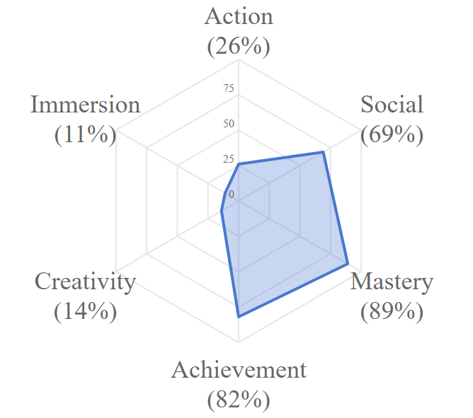
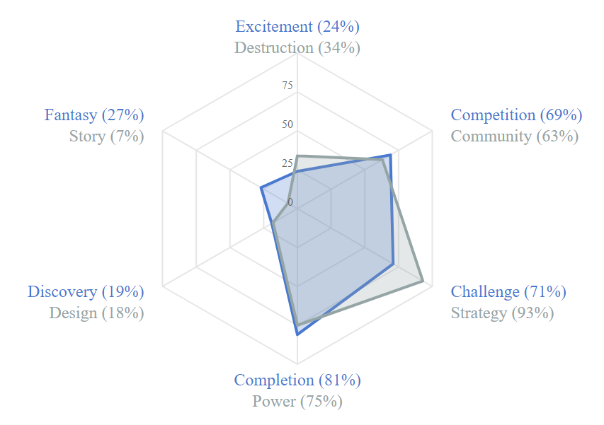
Mr Oon’s Gamer Motivation Profile
Notes:
Incidentally, this is my Gamer Motivation Profile as of 2019. As you can see, I am quite high on the Mastery-Achievement spectrum, moderate on the Social, and low everywhere else. Yes, I enjoy pitting my wits against the game and other players, and I do enjoy racking up points and achievements. Also, since I am an old fogey with slow reflexes, I find action games stressful. And I don’t know about you, but I usually skip the cut-scenes after the first few times so that I can get to the gameplay faster, and why would I want to waste time customizing the look of my character if it has no in-game effect? Limpeh’s time is precious!
In case you’re wondering, some of my favourite games are Hearthstone, Civilization, FTL and Slay the Spire, and I’ve logged 3500+ hours on an idle game called Shop Heroes. I used to play both chess and Magic: the Gathering competitively. Oh, and I own over 700 board games. This profile seems pretty accurate, huh? So, how accurate is your profile?

Slide 11

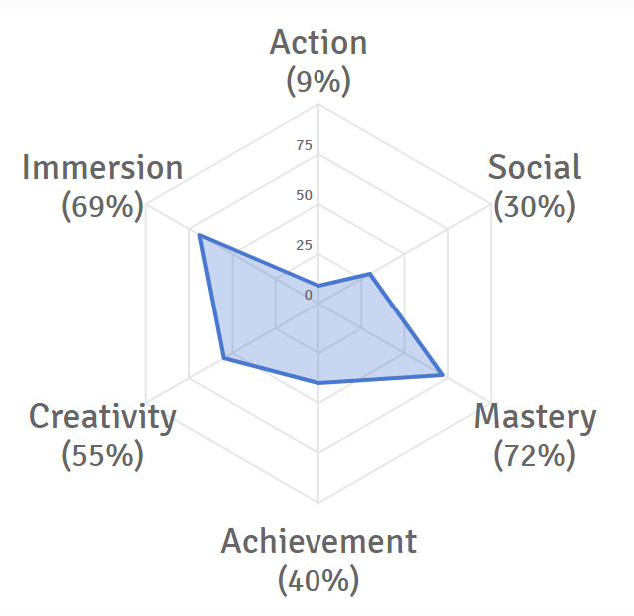
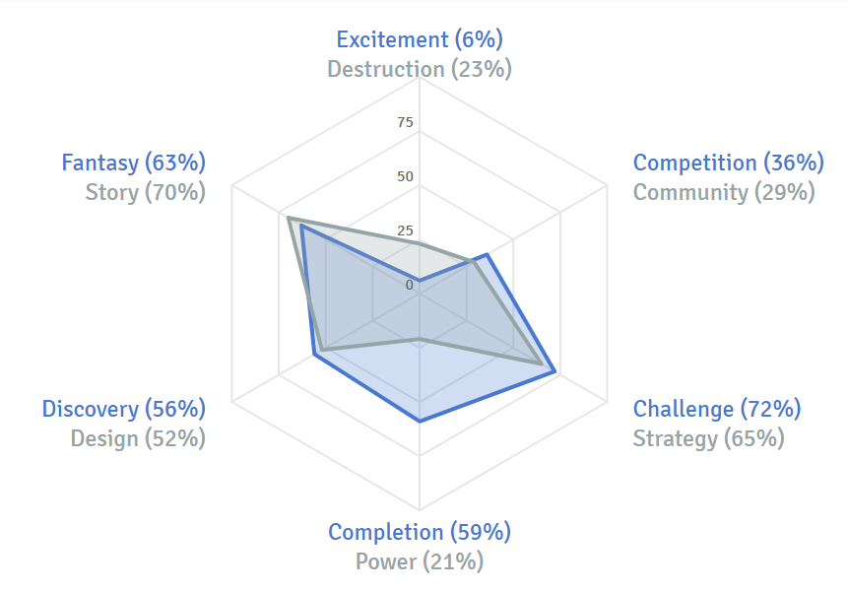
Ms Lee’s Gamer Motivation Profile

Slide 12
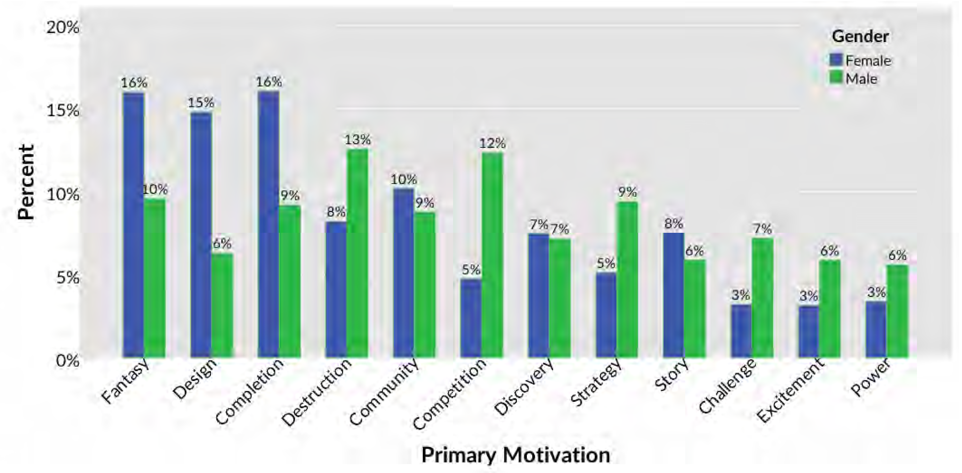
Gender Differences
Notes:
Here are a few more interesting things that the survey data revealed. Firstly, how does gender affect a gamer’s primary motivation? Well, it seems that many of the gender stereotypes are accurate. As expected, more males were primarily motivated by Destruction, Competition and Excitement. Males also favoured Strategy, Challenge and Power more than females. Is this because of the male desire to prove themselves to be better than others? We can only speculate.
On the other hand, females prefer Fantasy, Design and Completion. So if you are making a game with the intention to attract a female audience, this data suggests that a game with a detailed and rich world, avenues for the player to design their character and/or lots of achievements and missions to complete would be a good idea.

Slide 13
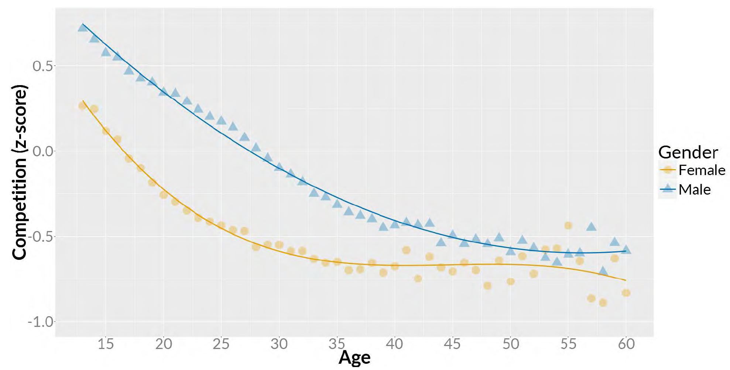
Gender vs. Age
Difference between
youngest and
oldest men
Largest
difference between
men and women
Notes:
But don’t spend too much effort of distinguishing by gender, because the surprising conclusion in the data is that age is actually a much more significant factor. This graph shows how much gamers of different ages favour competition in their games. Yes, there is certainly a difference between men and women, with the blue line higher than the green, with the largest difference shown here.
But the difference is much more significant between the youngest and oldest men, shown here. Apparently, it is not the gender of the person but rather the age that has the biggest impact on whether someone enjoys competition in their games. Like for me, I used to enjoy competition in my games a lot more when I was younger, but now when I play games, I just want to relax. (sigh) I’m old.

Slide 14
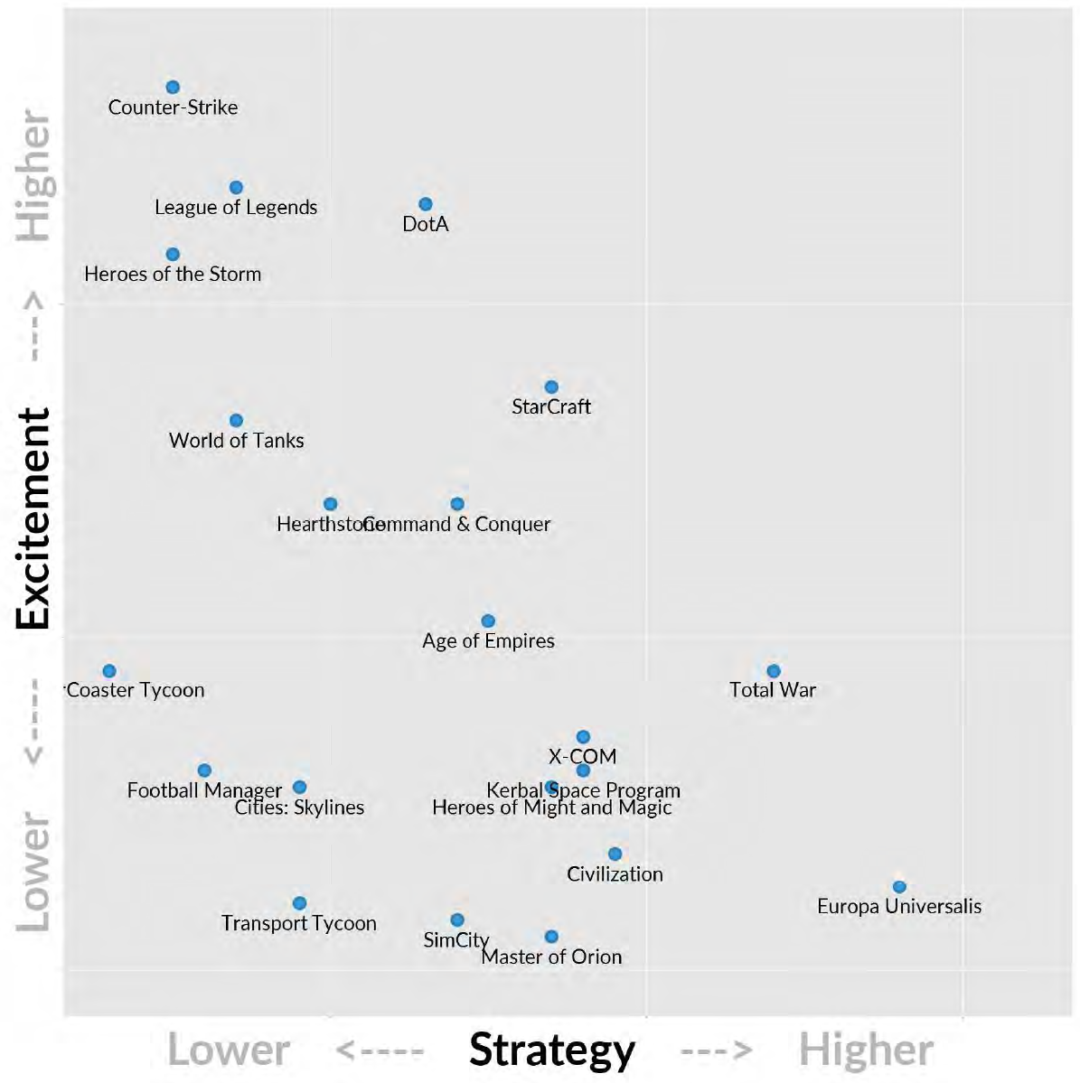
Cognitive Threshold
Cognitive
Threshold
Notes:
Finally, let me show you one last diagram. This data shows the existence of what Quantic Foundry called the Cognitive Threshold. This graph maps the people who specified certain games as one of their favourites based on their scores on the Excitement and Strategy scales. We see that people who really like Excitement but not Strategy play games like Counter-Strike and LOL. Those who really like Strategy but not Excitement play Europa Universalis, Total War and Civilization. And then there are all the games in between.
Notice that the top right-hand corner to this graph is empty. This is because there are no mega-successful games that are high on both Excitement and Strategy. Intuitively, this makes sense since if the game is highly strategic, you need more time to plan, and vice versa. The line separating this part of the graph from the rest of the graph is called the Cognitive Threshold.
What is also interesting is that the most popular e-Sports hover around the top part of the Cognitive Threshold. Games like Counter-Strike, LOL, DOTA and Starcraft are high in Excitement while pushing the boundaries of strategic play, making them compelling spectator events.

Slide 15
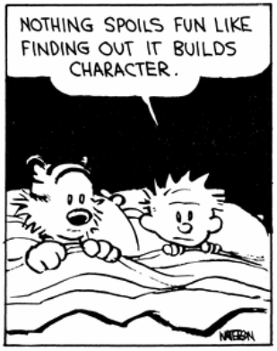
Now What?
Different people like different games
Affected by personality, age, gender, etc.
Determine your target audience
May affect design decisions, marketing, platform, etc.
Games can fulfill needs in a safe, simulated environment
Social, self-esteem, self-actualization
Notes:
OK, great, now what? We have looked at some theories on why people play games, including Maslow’s Hierarchy of Needs from the field of sociology, Bartle’s Taxonomy of Player Types, and Quantic Foundry’s Player Motivation Profile. We know that game preferences are affected by lots of factors, like social stability, personality, age and gender.
And while a lot of this is common sense, it is important to determine the target audience for your game. If you are designing a game with twitch gameplay and lots of violence and destruction, expect more males and a younger audience. A social game where you can customize your own pet shop? Probably a larger proportion of females and an older demographic who don’t have time to spend hours at a time playing the game. Once you figure out your audience, this will inform the development of your game, from gameplay features and theme to marketing and payment model.
Strictly speaking, games by definition do not matter. Except in the rare case of the professional gamer, games have no obvious positive impact financially. But the fact is, games are important as they can provide an avenue for companionship, allows you to gain recognition from others for your l33t gaming 5k1llz, or even just to get the satisfaction of solving every single Riddler riddle in Arkham City, and these are basic human needs. So, go ahead, play games and have fun – it builds character. Just do your work first, okay?

